Slide 1

Forex Pair Price Forecasting with Time Series Machine Learning Models
DS106 capstone project
By:
Gary Ong Choon Wee
Jo E Yaw Huei

Slide 2

Problem Statement
To forecast forex pair pricing with time-series machine learning models.

Slide 3
Background
The foreign exchange (also known as FX or forex) market is a global marketplace for exchanging national currencies.
Currencies trade against each other as exchange rate pairs. For example, EUR/USD is a currency pair for trading euro against the US dollar.
Forex markets exist as spot (cash) markets as well as derivatives markets offering forwards, futures, options, and currency swaps.
Market participants use forex to hedge against international currency and interest rate risk, to speculate on geopolitical events, and to diversify portfolios, among several other reasons.

Slide 4

Dataset
Hourly price data for EURUSD from Apr 2011 to Mar 2021 (10 years), each pair about 65,000 rows of data.
Source of the data: MetaTrader 4 (MT4).
Link to the data:
https://github.com/onggreat
https://github.com/joeyh28/DS106

Slide 5
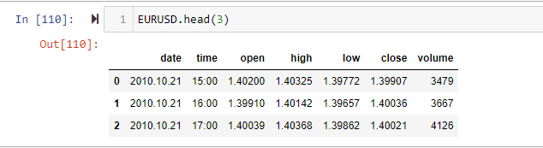
Dataset Sample
Example of the dataset:

Slide 6
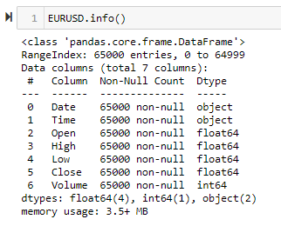
Dataset Information
For each of the Forex Pair, the dataset consist of the following columns:
Date - Date of the transaction record
Time – Opening/Starting time of the transaction record
Opening – Opening price of time period
High – Highest recorded price within the time period
Low – Lowest recorded price within the time period
Close - Closing price of the time period
Volume – Transacted volume within the time period

Slide 7
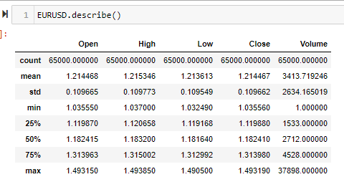
Data Exploration and Pre-processing
Ensure there is no empty cell in the dataset
Understand the data type

Slide 8
Time Series Data
Time series data is a collection of observations obtained through repeated measurements over time. Plot the points on a graph, and one of your axes would always be time.
Time series data can be useful for:
Tracking daily, hourly, or weekly weather data
Tracking changes in application performance
Medical devices to visualize vitals in real time
Tracking network logs

Slide 9
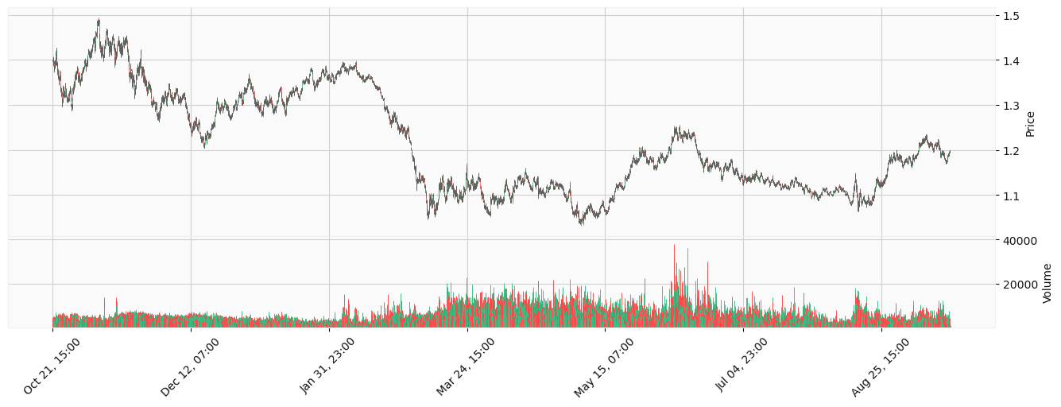
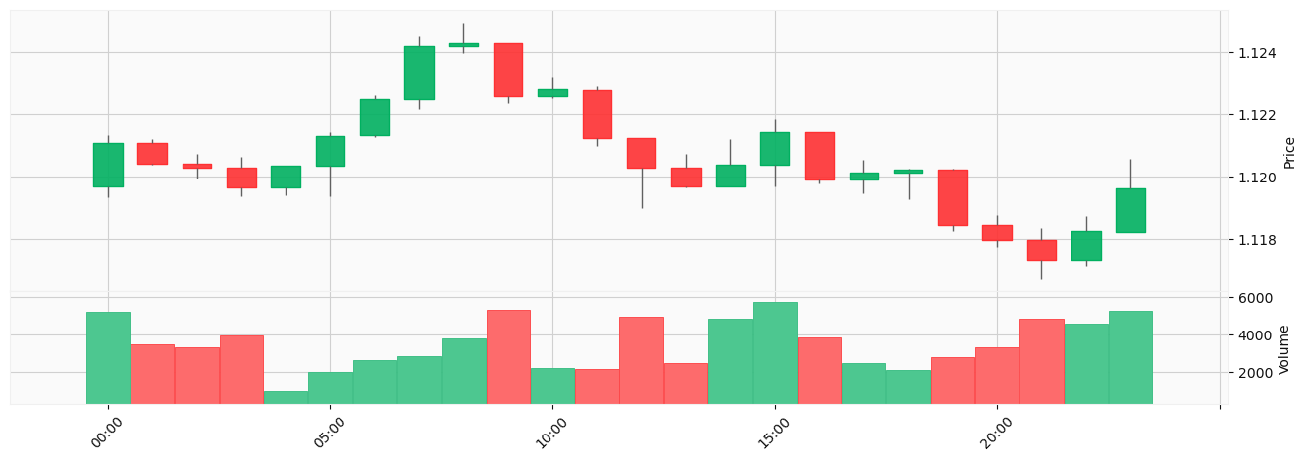
Visualization of the Dataset
Candle stick Plot, OCHL

Slide 10
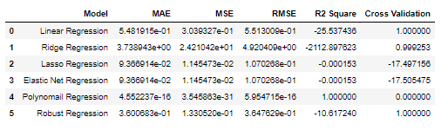

Summary of Evaluation
Regression Models Evaluation
MAE: Mean Absolute Error
MSE: Mean Square Error
RMSE: Root Mean Square Error

Slide 11
Important Concept/Properties of Time Series Analysis

Slide 12
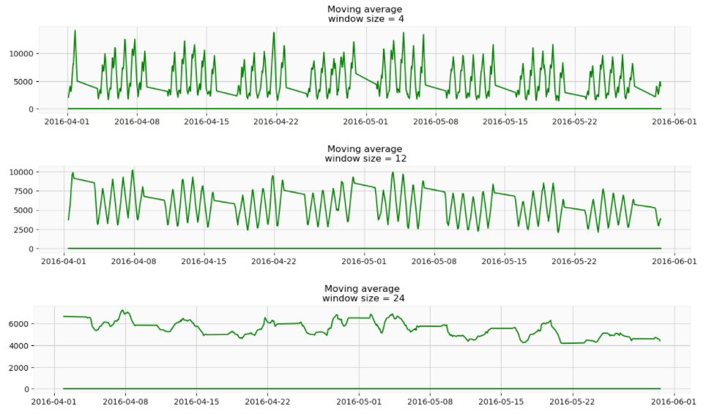
1. Smoothing Effect of Moving Average
Observation:
The wider the window, the smoother the trend. In the case of very noisy data, which is often encountered in finance, this procedure can help detect common patterns.

Slide 13
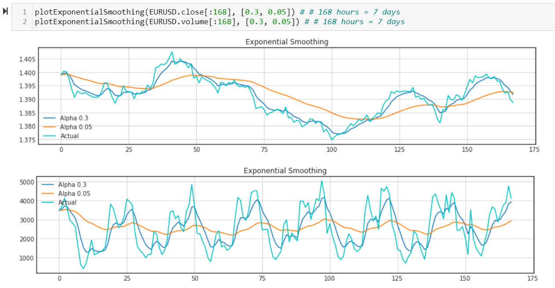
2. Weighted Exponential Smoothing
Weighted exponential average is a simple modification to the moving average. The weights sum up to 1 with larger weights assigned to more recent observations.
The moving average model to smooth our time series.
We experiment with different alpha parameter to get better looking curves.

Slide 14
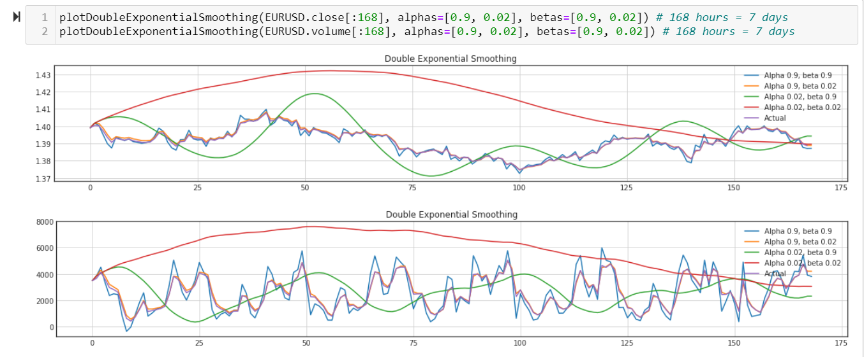
3. Exponential and Double Exponential Smoothing
Experiment with different alpha and beta combinations to get better looking curves.

Slide 15
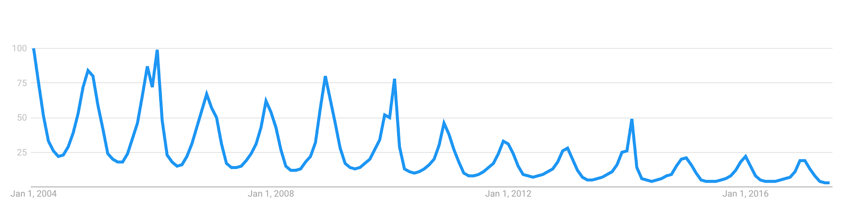
4. Seasonality - Repeating Trends
Google Trends - “Snowboarding”

Slide 16
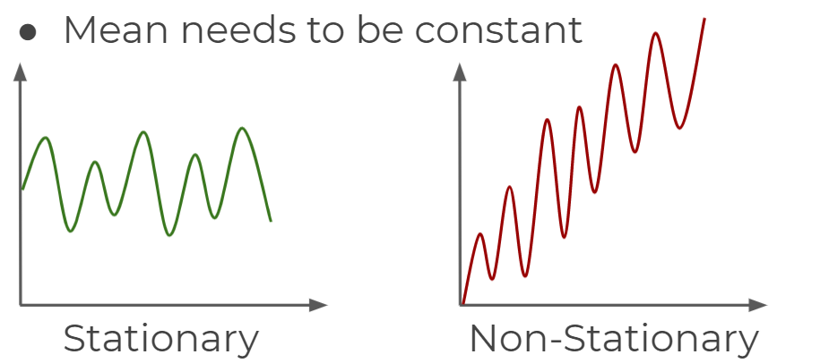
5. Stationary vs Non-Stationary Data
Stationary Time Series
Mean needs to be constant
Variance should not be a function of time
Covariance should not be a function of time
Non-Stationary Time Series
Mean not constant
Variance is a function of time
Covariance is a function of time
Dickey–Fuller test can be used to determine time-series stationarities
If data is not stationary, it need to be transformed to be stationary in order to evaluate it and what type of ARIMA terms you will use.

Slide 17
6. Stationary vs Non-Stationary Data
Stationary Time Series
Mean needs to be constant
Variance should not be a function of time
Covariance should not be a function of time
Non-Stationary Time Series
Mean not constant
Variance is a function of time
Covariance is a function of time
Dickey–Fuller test can be used to determine time-series stationarities
If data is not stationary, it need to be transformed to be stationary in order to evaluate it and what type of ARIMA terms you will use.

Slide 18
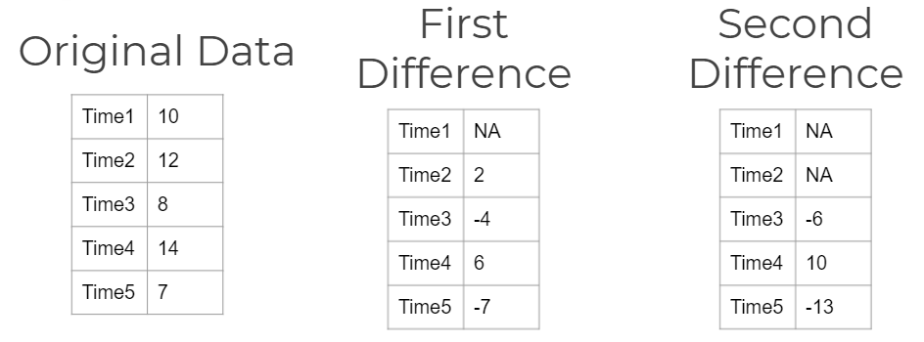
7. Differencing
We can continue differencing until we reach stationarity
Each differencing step comes at the cost of losing a row of data!

Slide 19
Datetime Series Analysis Forecasting Models
Time Series Analysis with Statsmodels
Holt-Winters Method
Time Series Forecasting Model:
ARIMA (p,d,q)
SARIMA(p,d,q) (P,D,Q)
Seasonal Autoregression Average Model, seasonal component (P,D,Q)
SARIMAX
SARIMA model that support supports exogenous regressor variables.

Slide 20
1. Holt-Winters Method
It was first suggested by C.C. Holt in 1957 and was meant to be used for non-seasonal time series showing no trend. He later offered a procedure (1958) that does handle trends.
Winters(1965) generalized the method to include seasonality, hence the name "Holt-Winters Method".
The Holt-Winters Method has 3 updating equations, each with a constant that ranges from 0 to 1. The equations are intended to give more weight to recent observations and less weights to observations further in the past.
These weights are geometrically decreasing by a constant ratio.
The HW procedure can be made fully automatic by user-friendly software.

Slide 21
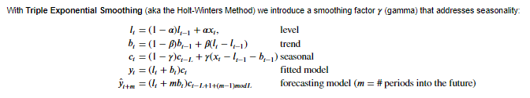

1. Holt-Winters Method
$$α=level smoothing factor$$
$β$ = trend smoothing factor
$$γ=seasonal smoothing factor$$

Slide 22
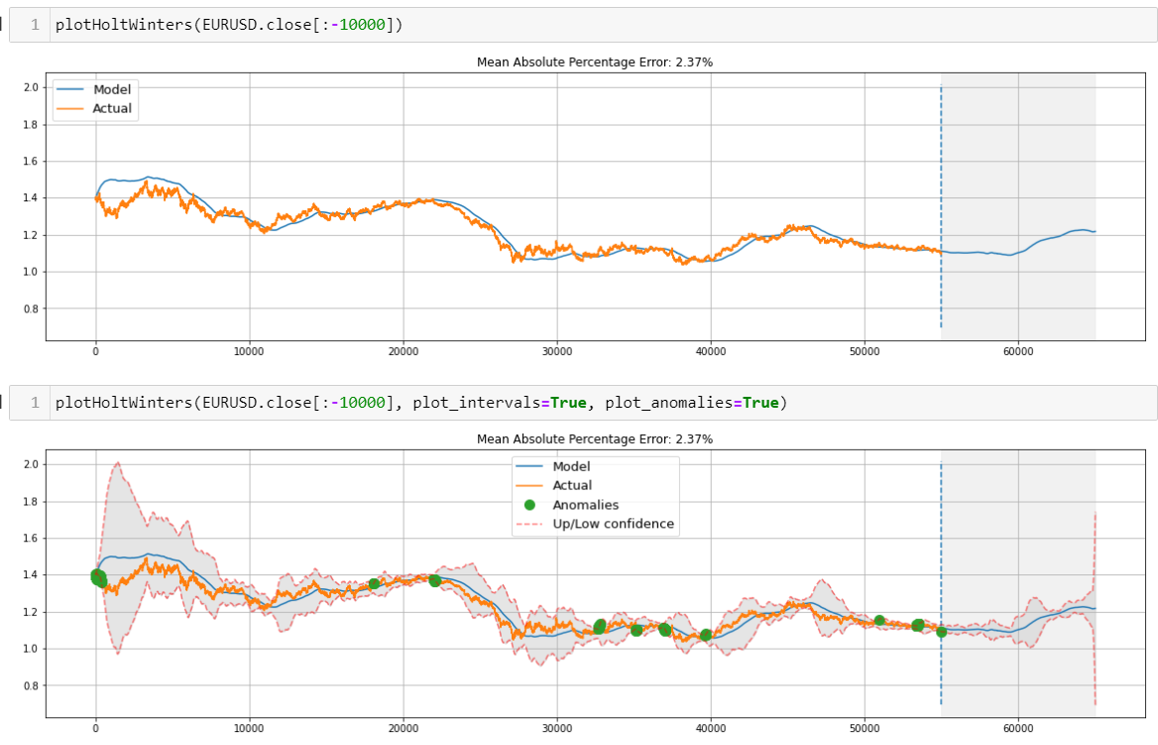
1. Holt-Winters Method
Judging by the plots, the model was able to successfully approximate the initial time series, capturing the daily seasonality, overall downwards trend, and even some anomalies.
If you look at the model deviations, you can clearly see that the model reacts quite sharply to changes in the structure of the series but then quickly returns the deviation to the normal values, essentially "forgetting" the past.
This feature of the model allows us to quickly build anomaly detection systems, even for noisy series data, without spending too much time and money on preparing the data and training the model.

Slide 23
White Noise
White noise is an important concept in time series forecasting.
If a time series is white noise, it is a sequence of random numbers and cannot be predicted.
If the series of forecast errors are not white noise, it suggests improvements could be made to the predictive model

Slide 24
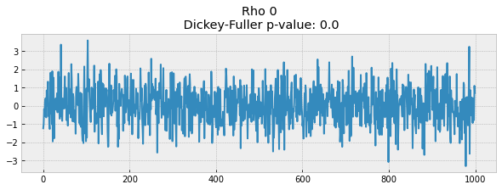
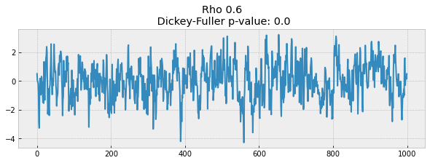
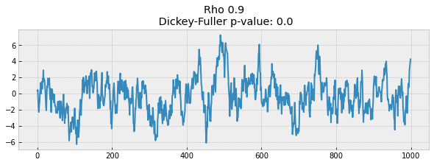
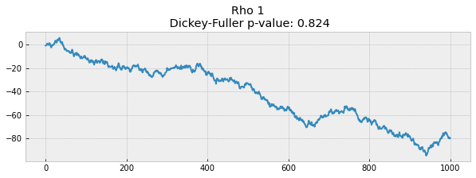
White Noise
On the first plot, you can see the same stationary white noise as before.
On the second plot with ρ increased to 0.6, wider cycles appeared, but it still appears stationary overall.
The third plot deviates even more from the 0 mean but still oscillates about the mean.
Finally, with ρ=1 , we have a random walk process i.e. a non-stationary time series. This happens because, after reaching the critical value, the series xt=ρxt−1+et does not return to its mean value. If we subtract xt−1 from both sides, we will get xt−xt−1=(ρ−1)xt−1+et , where the expression on the left is referred to as the first difference. If ρ=1 , then the first difference gives us stationary white noise et .

Slide 25
2. ARIMA Model
ARIMA model formed by 3 components (3 parameters)
AR - AutoRegression
I - Integrated
MA - Moving Average
AR – AutoRegression (Parameter p = number of time lags)
The AR part of ARIMA indicates that the evolving variable of interest is regressed on its own lagged (i.e., prior) values.
I – Integrated (Parameter d = degree of differencing)
Indicates that the data values have been replaced with the difference between their values and the previous values
MA - Moving Average (Parameter q = order of the moving average)
Indicates the regression error is actually a linear combination of error terms whose values occurred contemporaneously and at various times in the past.

Slide 26
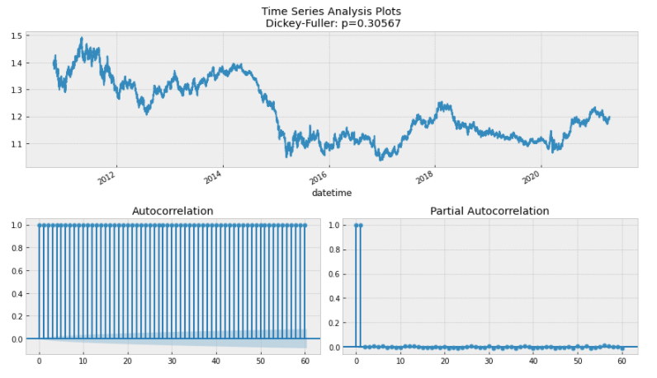
2. ARIMA Model
Surprisingly, the initial series are non-stationary. The Dickey-Fuller test, the time series is unsurprisingly non-stationary. Also, looking at the autocorrelation plot, we see that it is very high, and it seems that there is no clear seasonality The only thing left is seasonality, which we have to deal with prior to modeling. To do so, we take the "seasonal difference", which means a simple subtraction of the series from itself with a lag that equals the seasonal period

Slide 27
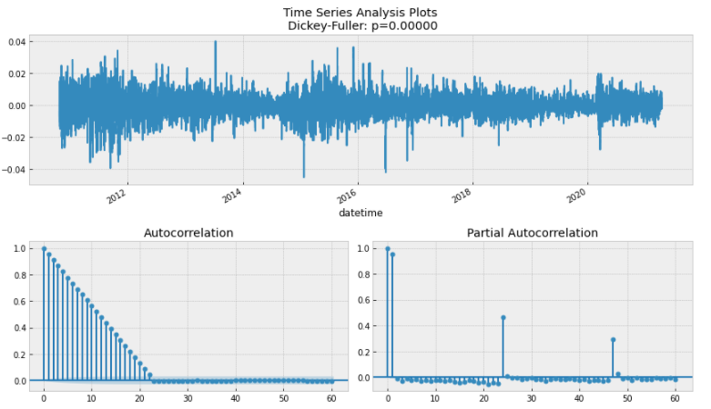
2. ARIMA Model
It is now much better with the visible seasonality gone. The autocorrelation function do not have many significant lags, oscillating around zero. The Dickey-Fuller test indicates that it is stationary, and the number of significant peaks in ACF has dropped

Slide 28
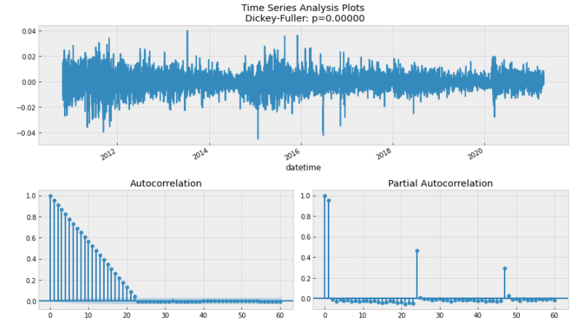
2. ARIMA Family

Slide 29
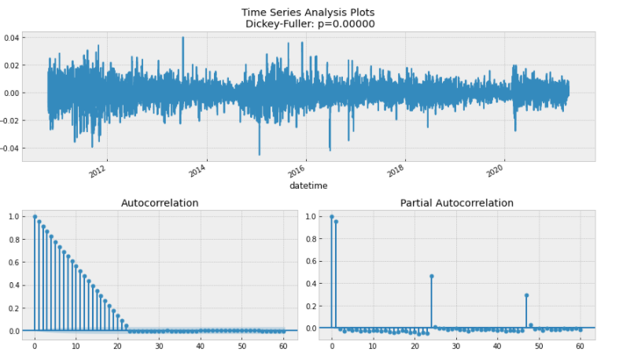
2. ARIMA Family

Slide 30
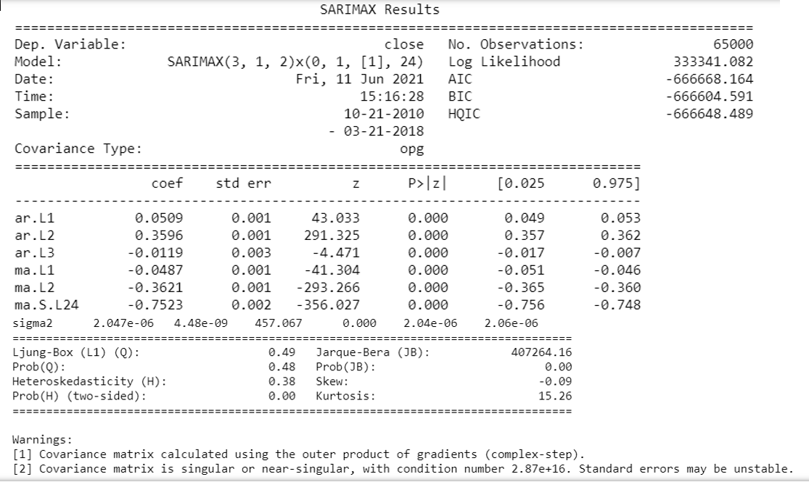










3. SARIMAX
We engineered the following additional features as exogenous regressor variables:
Year
Weekday
Hour
Is Weekend (Boolean)
We have 36 different combinations created from the 6 SARIMA parameters.
We tried each combination and trained SARIMA with each so to find the best performing model.
Here is the summary of the best model.

Slide 31
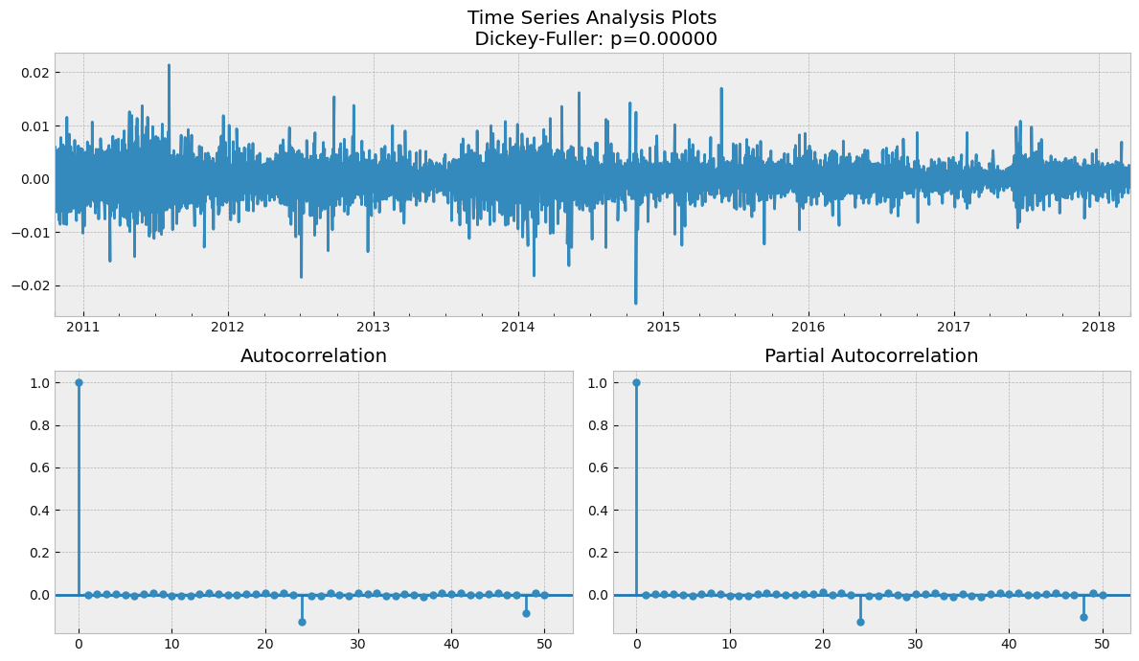
3. SARIMAX

Slide 32
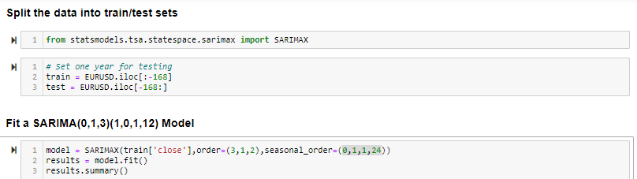
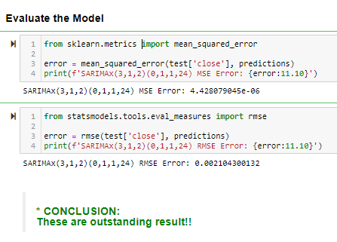
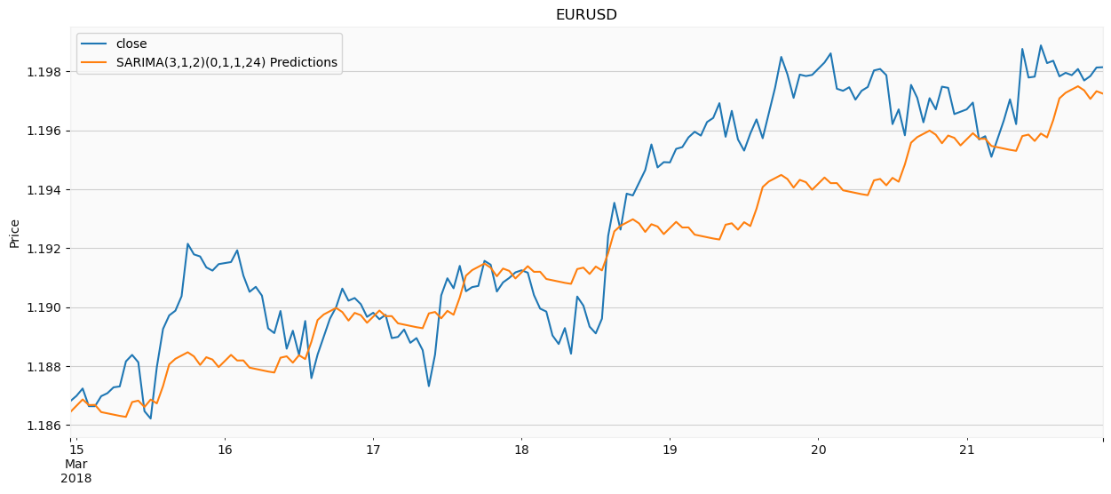


3. SARIMAX

Slide 33
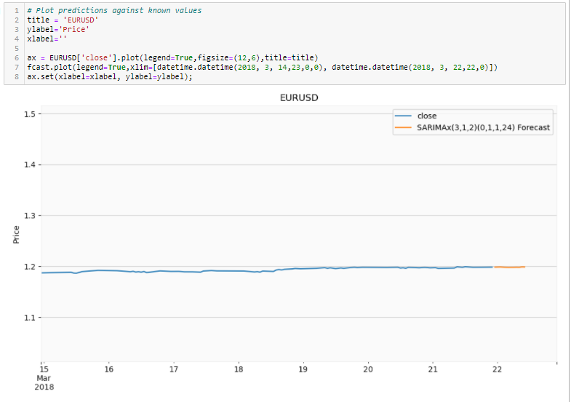
3. SARIMAX
Retrain the model on the full data, and forecast the future

Slide 34
Challenges and Limitation
1. Forex prices changes are affected by many factors actually, our model has not able to factor all foreseeable repeated seasonal trend, example:
Scheduled economical government announcement (like non-farm employment rate by US)
Respective countries’ holidays
The model we worked on was based on historical data imported from csv file, it will be better if we can get live data to get most recent dataset

Slide 35
Enhancement
Start
API link to MT4 fetch historical data
Import Data to Python for Analysis
EDA
Applying ML model
Collecting record of executed trade
API link back to MT4 for order execution
Translating predicted price movement to MT4 order
ML predict price movement
End

Slide 36
THE END

